Slide 1

Hotel Bookings: „To Cancel or not to cancel“
Diana Jaffé Code Academy
June 11,2021

Slide 2
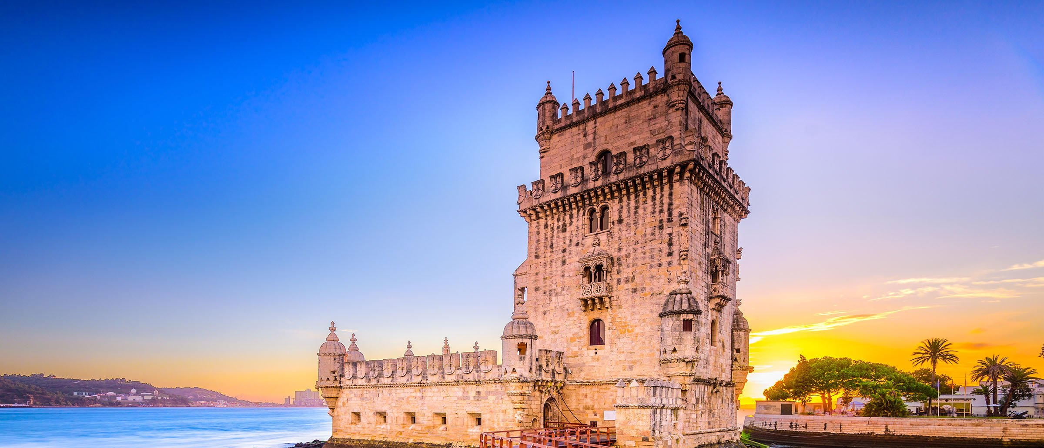
Hotel Bookings: „To Cancel or not to cancel“
Diana Jaffé Code Academy, 06/11/2021

Slide 3
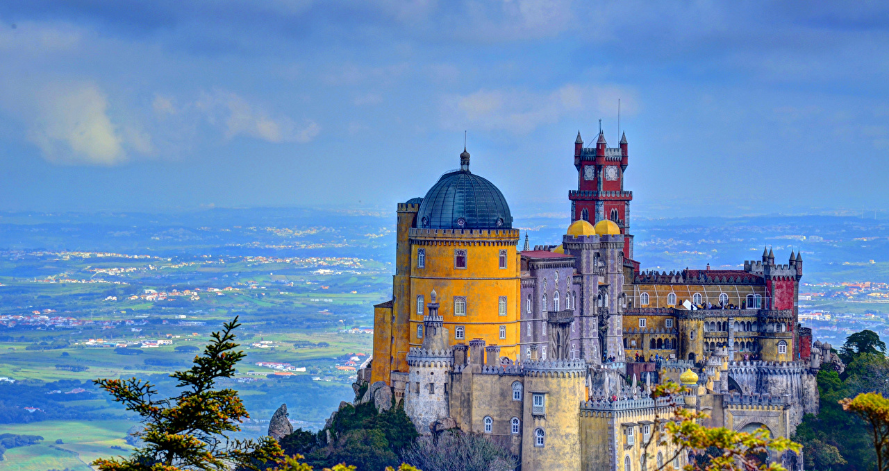
Hotel Bookings: „To Cancel or not to cancel“
Diana Jaffé Code Academy, 06/11/2021

Slide 4
HOTELs: „To cancel or not to cancel“
Where does the data come from?
A tiny little bit about the Portugese travel market.
Hidden secrets in the data.
Machine Learning: Can „the machine“ foretell people‘s behavior?

Slide 5
the portugese touristic Market - 2018
Tourism made 8.52% of the Portugese GDP in 2018.
International travelers make 71% of the 57.6m overnight stays in hotels.
This equals 12.7m arrivals of international guests.
Overnight stays in hotels have dropped in a range from 1% - 5% since 2016.
RevPAR has nevertheless increased.

Slide 6
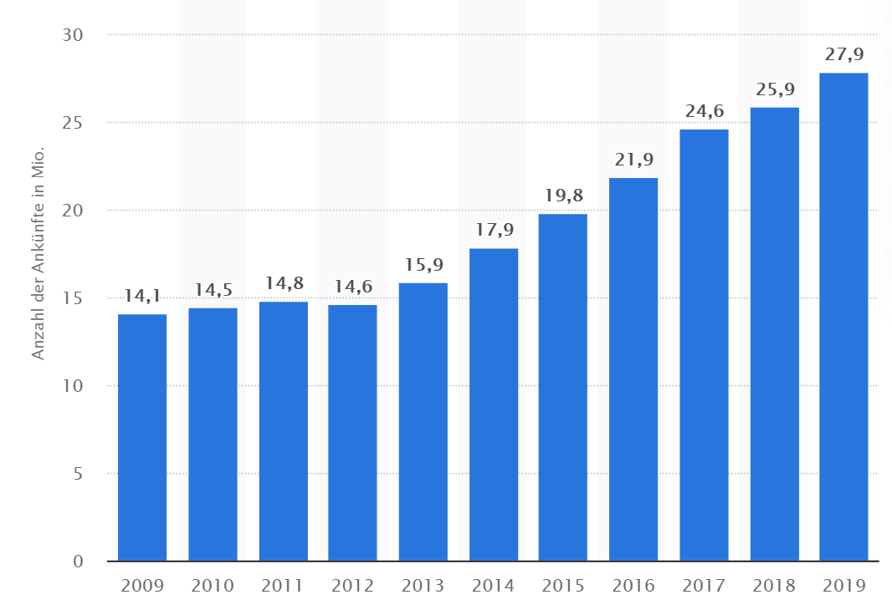
tourist arrivals AT accomodation Providers in Portugal 2009 – 2019 in mill.

Slide 7
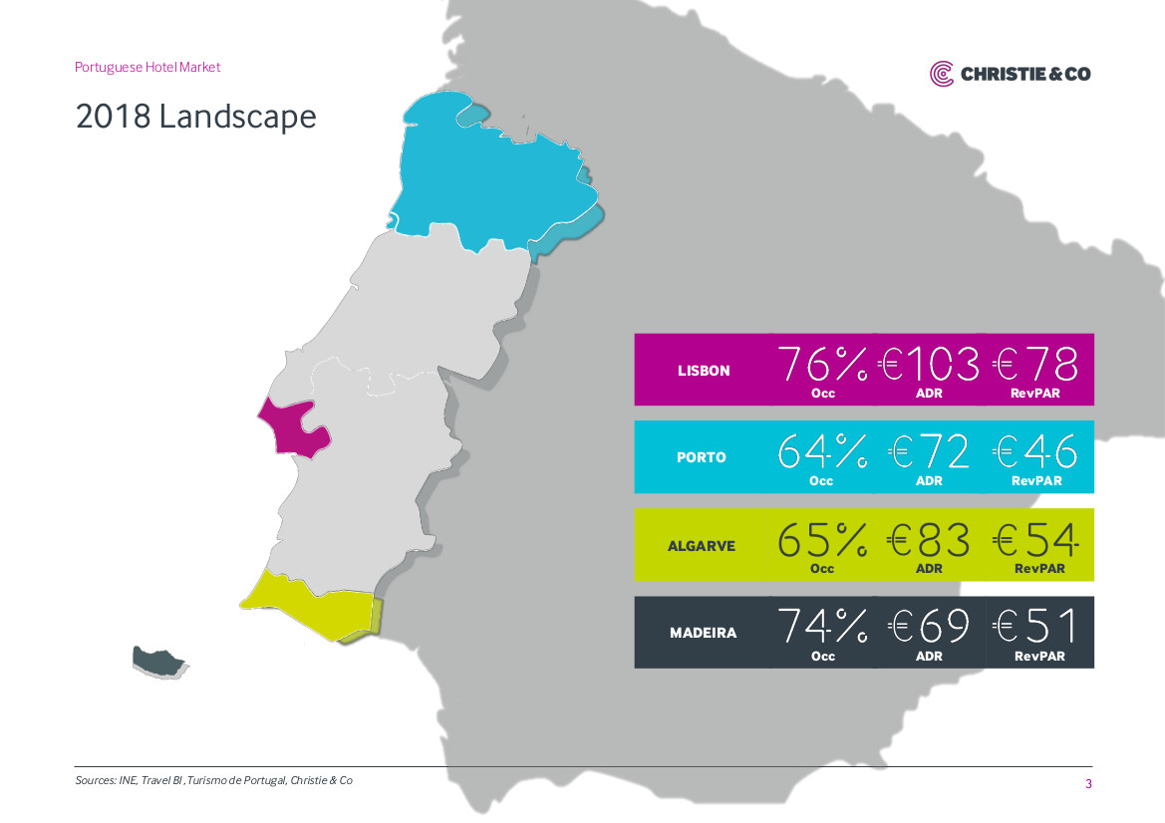
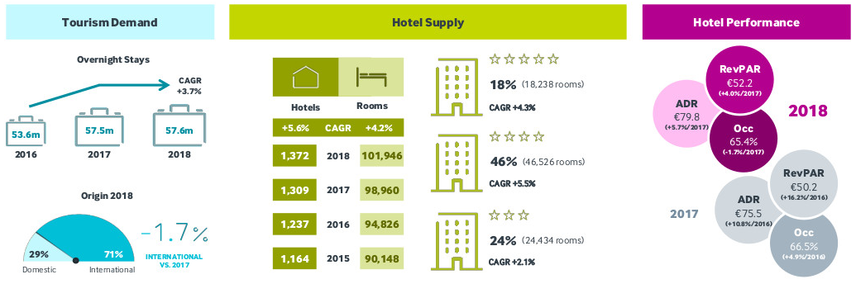
Market information

Slide 9

THE Beauty - of data
Good Data Paints A Picture Of The World.

Slide 10
KPI
Everything is interesting.
Especially people‘s behavior.

Slide 11
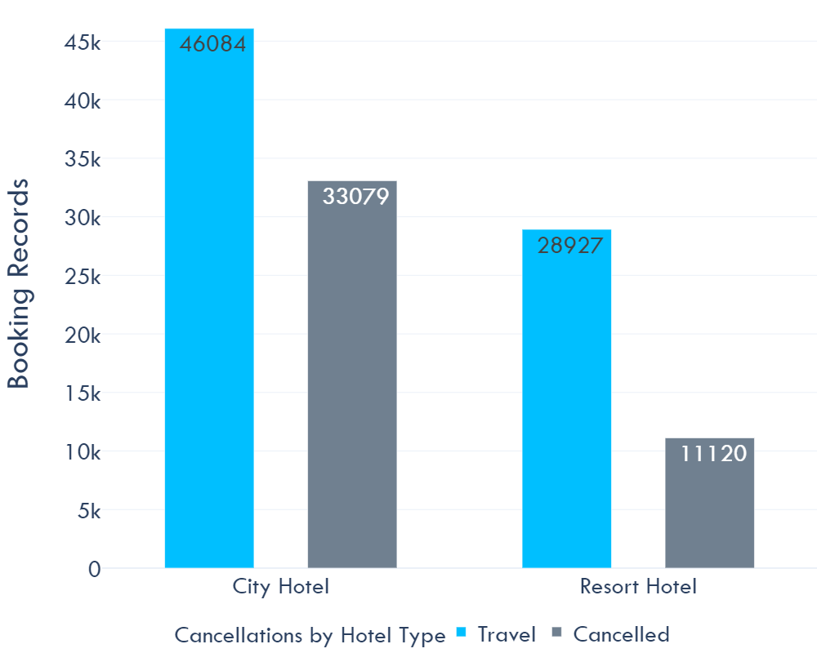
Data structure

Slide 12
Findings
The guests of the 2 hotels originate from 178 countries!
It‘s surprising how buggy many published data explorations and machine learning codes are! And some of the publishers look so professional that you would not doubt what they write – unless you want to work with their codes. So beware!
No matter how long you work with the data – senseless or corrupt data keeps appearing all the time. E. g.:
251 records for City Hotels are neither canceled, nor do they have overnight stays; the price (adr) == 0
Same is true for 371 bookings in the category Resort Hotel.

Slide 13
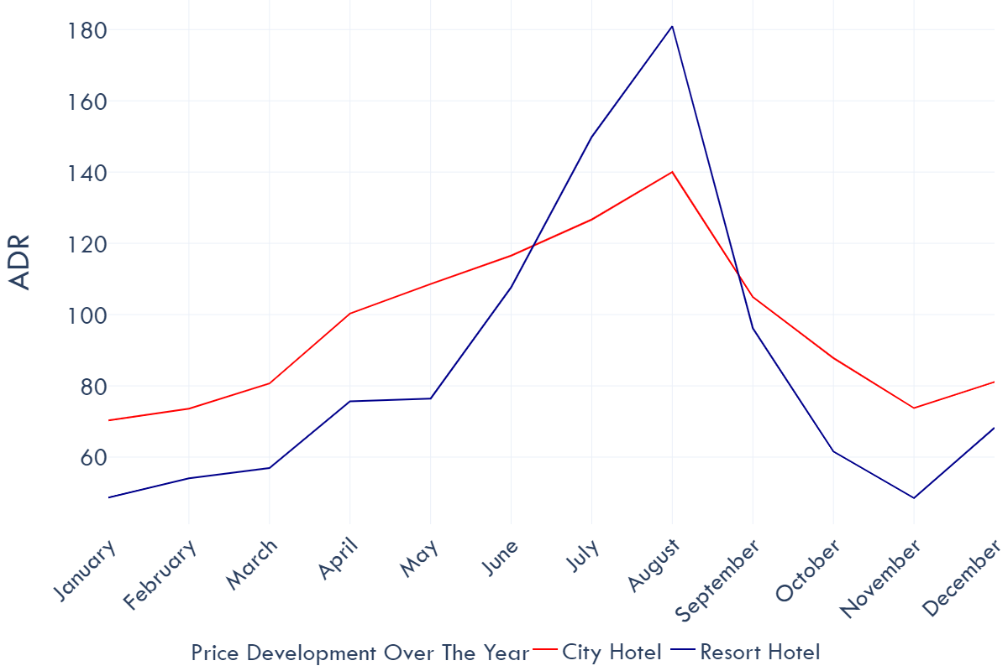
Mean ADR changes by season / Month

Slide 14
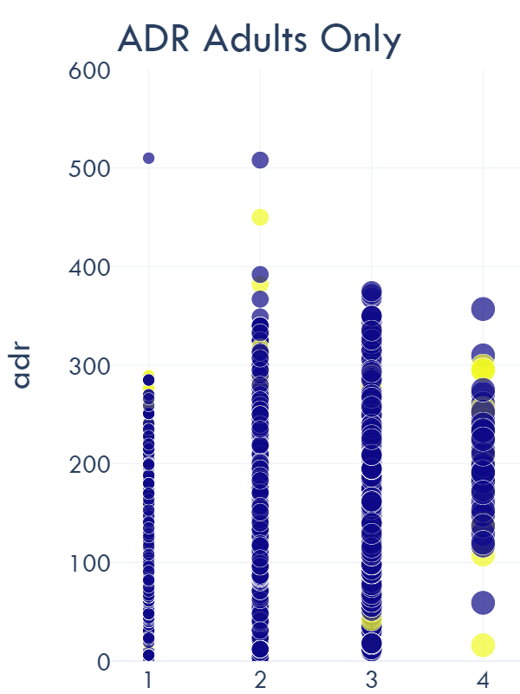
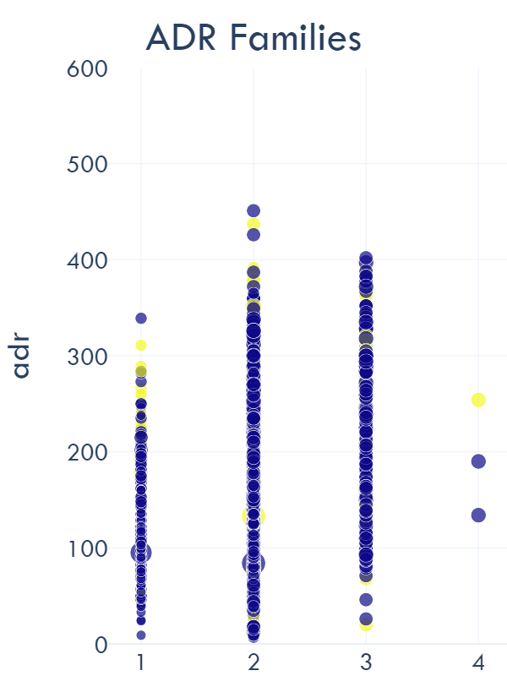
ADR by Adults only / Families (TRAVEL/CANCELLATION)

Slide 15
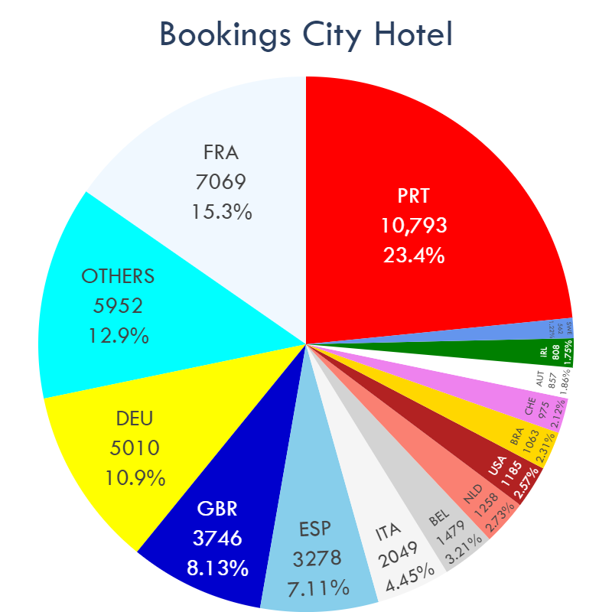
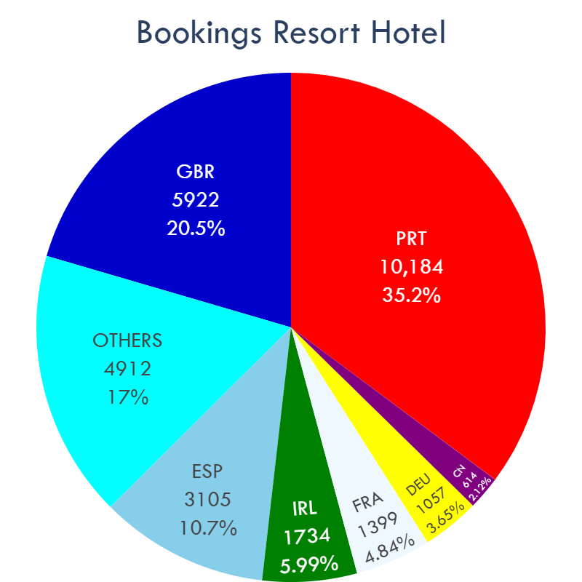
bookings by country and hotel type

Slide 16
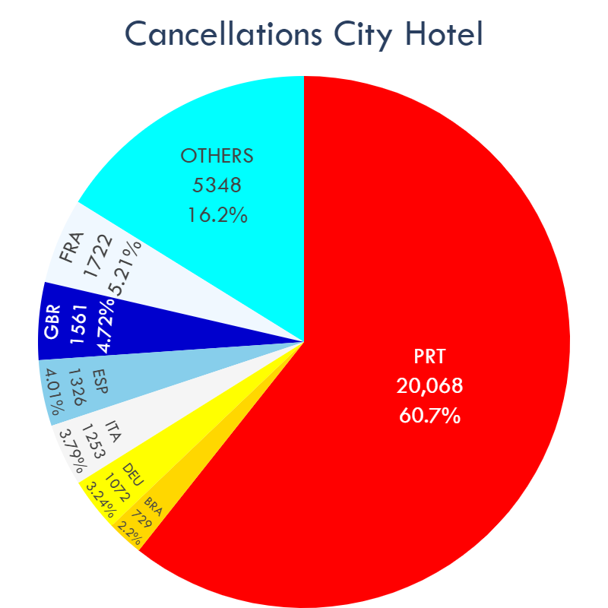
bookings and cancellations by country

Slide 17
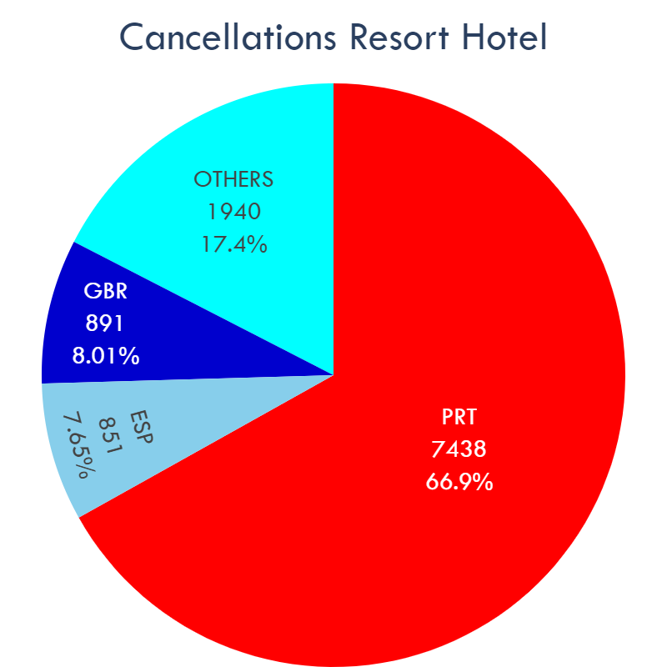
bookings and cancellations by country

Slide 18
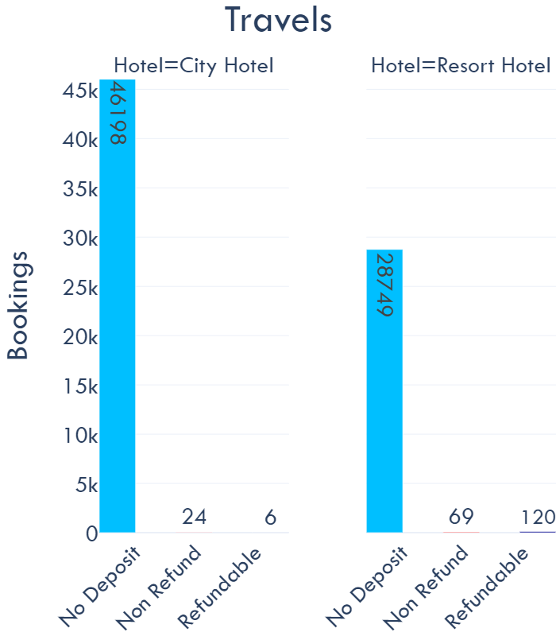
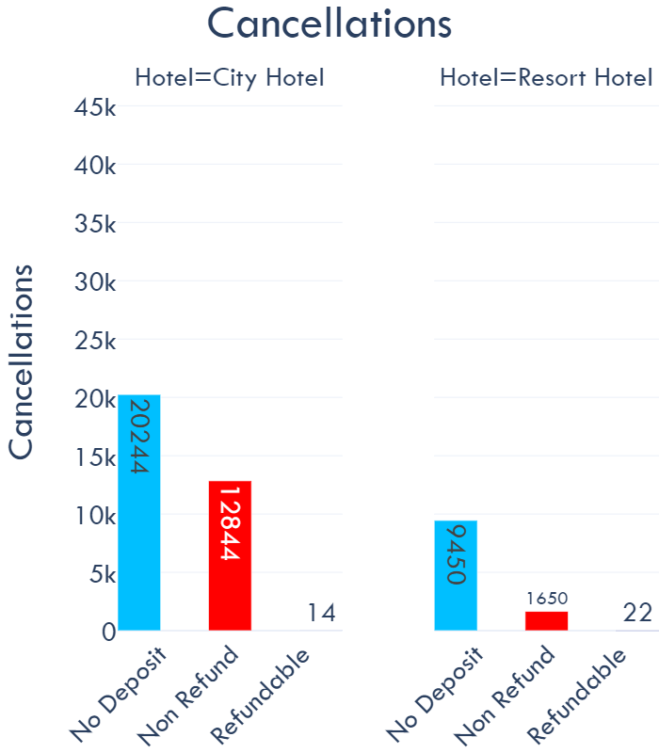
bookings and cancellations by country

Slide 19
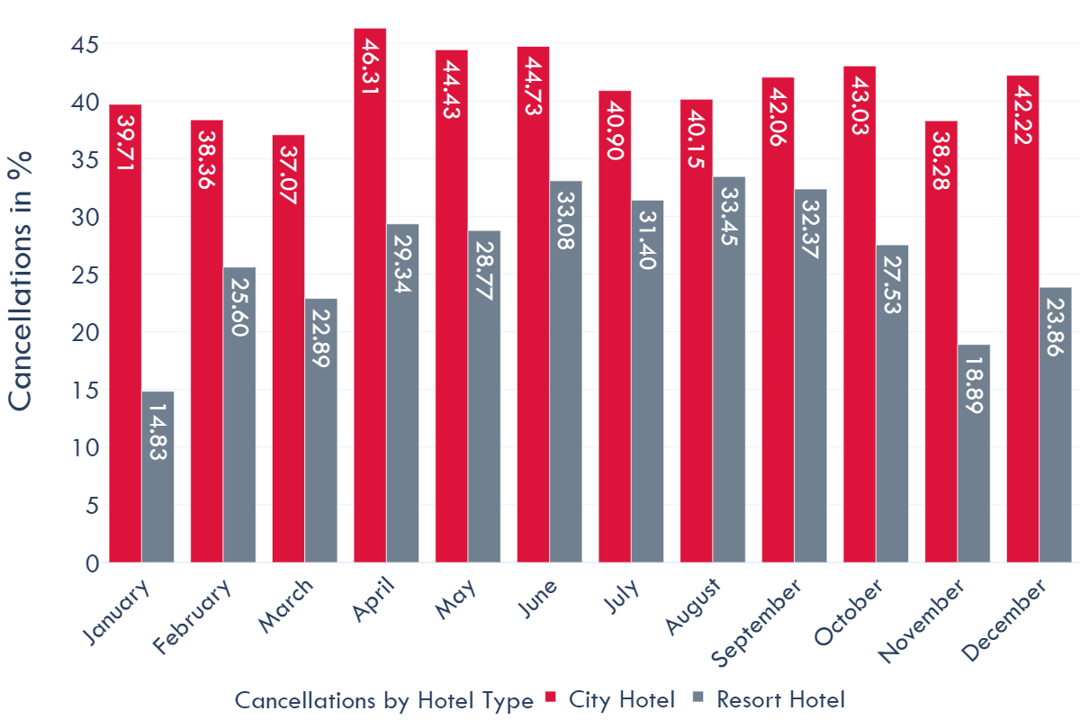
CANCELLATion Rate per month in %

Slide 20
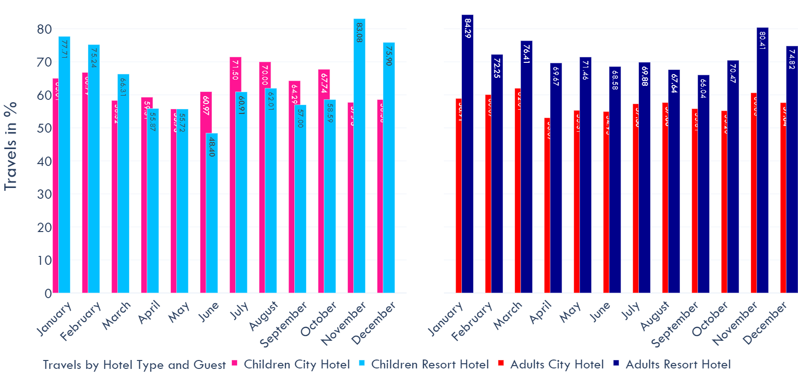
Travel Rate (positive for no cancellation)

Slide 21


Slide 22
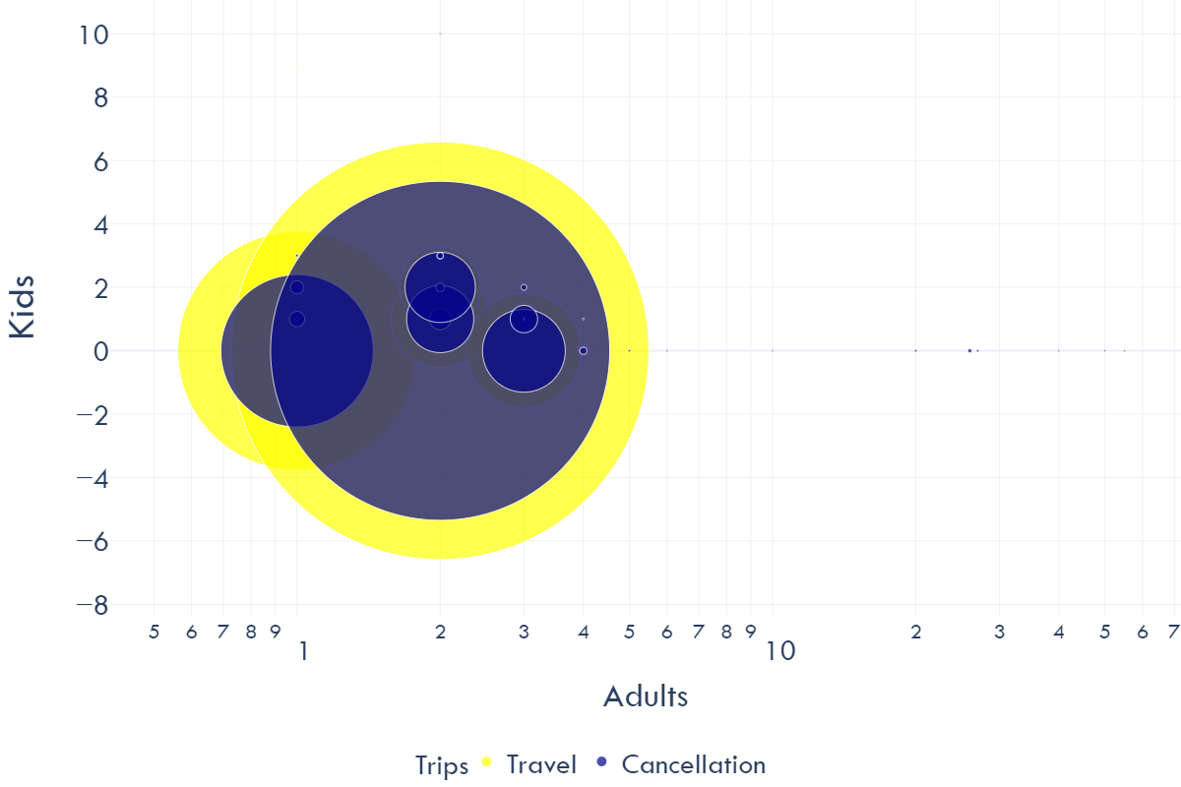
Travel and cancellation Rates by travel constellations: Singles, Families, groups etc.

Slide 23
Life (and business) begins Where data ends
Questions:
[How can businesses prevent senseless or corrupt data in their systems? Or is that just part of a very special information gathering?]
What are the reasons for the vast cancellation rates for resort hotels in summer of families with children?
Can hotel owners can do anything to change this (not only for their businesses, but also for families‘ sake)?
Are resort hotels always fully booked in summer so they don‘t have to care about cancellations? – We did not get any occupation rates for the two hotels.
But not everything is always just business…

Slide 25

Can a machine predict people‘s behavior in the future?

Slide 26
Trying to tackle the cancellation question
 | MODEL | SCORE | KAPPA
1 | Random Forest Classifier | 0.891871 | 0.765818
2 | Decision Tree Classifier | 0.855423 | 0.691746
3 | KNN | 0.835123 | 0.643846
4 | K-Fold Decision Tree Classifier | 0.819173
5 | Logistic Regression | 0.792928 | 0.529230

Slide 27

„Nice. But you can do better.“
Accuracy > 90 %
Kappa > 80%

Slide 28
And I tried harder…
Strategies
Classification Methods
Standardization
Normalization
Dummification
Outlier deletion
Correlation Matrix
Feature selection
Splitting hotel data
Different random states.
Logistic Regression
Decision Tree
K-Fold Decision Tree
KNN
Random Forest
Ada Boost Classifier
Gradient Boosting Classifier
XgBoost Classifier
Cat Boost Classifier
Extra Trees Classifier
LGBM Classifier
Voting Classifier

Slide 29
Trying to tackle the cancellation question
 | MODEL | SCORE | KAPPA
1 | Random Forest Classifier | 0.894053 | 0.770164
2 | Extra Trees Classifier | 0.889774 | 0.759985
3 | Voting Classifier | 0.879414 | 0.735213
4 | Cat Boost | 0.876730 | 0.733468
5 | XgBoost | 0.868258 | 0.714031
6 | LGBM | 0.863476 | 0.706467
7 | Decision Tree Classifier | 0.856094 | 0.693108
8 | Gradient Boosting Classifier | 0.849425 | 0.668910
9 | KNN | 0.835794 | 0.646068
10 | Ada Boost Classifier | 0.838520 | 0.644882
11 | Logistic Regression | 0.794313 | 0.535256

Slide 30

The Problem: imbalanced data

Slide 31
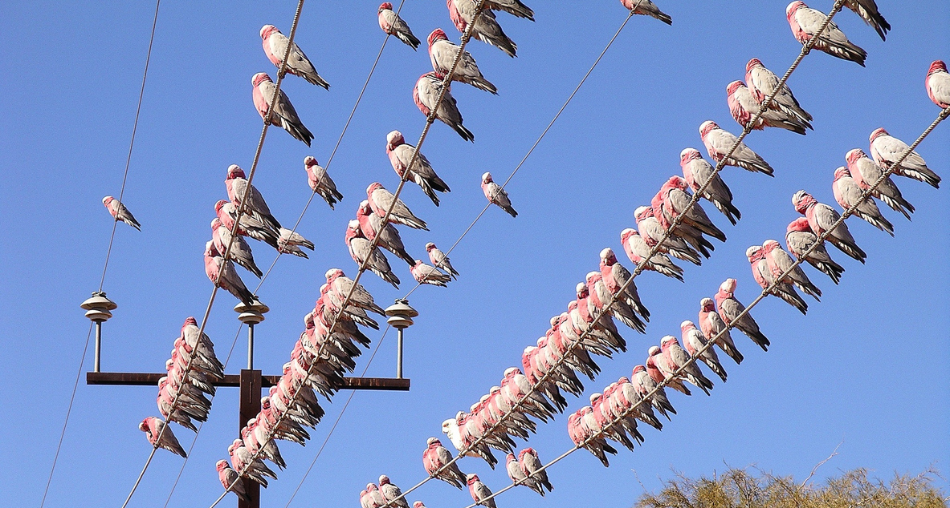
The solution: oversampling with smote

Slide 32
Oversampling with smote
SMOTE is an oversampling algorithm that relies on the concept of nearest neighbors to create its synthetic data. Proposed back in 2002 by Chawla et. al., SMOTE has become one of the most popular algorithms for oversampling.
The simplest case of oversampling is simply called oversampling or upsampling, meaning a method used to duplicate randomly selected data observations from the outnumbered class.
Oversampling’s purpose is for us to feel confident the data we generate are real examples of already existing data. This inherently comes with the issue of creating more of the same data we currently have, without adding any diversity to our dataset, and producing effects such as overfitting.
Hence, if overfitting affects our training due to randomly generated, upsampled data– or if plain oversampling is not suitable for the task at hand– we could resort to another, smarter oversampling technique known as synthetic data generation.

Slide 33
Finally THE Miracle…
 | MODEL | SCORE | KAPPA
1 | Random Forest Classifier | 0.931811 | 0.863627
2 | Extra Trees Classifier | 0.930645 | 0.861290
3 | K-Fold Decision Tree | 0.811953 | 0.811953
4 | Decision Tree Classifier | 0.904816 | 0.809642
5 | Voting Classifier | 0.894484 | 0.788964
6 | Cat Boost | 0.876487 | 0.752982
7 | XgBoost | 0.870488 | 0.740984
8 | LGBM | 0.866389 | 0.732787
9 | KNN | 0.842260 | 0.684540
10 | Gradient Boosting Classifier | 0.840927 | 0.681851
11 | Ada Boost Classifier | 0.839293 | 0.678582

Slide 34
What Is Revenue Per Available Room (RevPAR)?
Revenue per available room (RevPAR) is a metric used in the hospitality industry to measure hotel performance. The measurement is calculated by multiplying a hotel's average daily room rate (ADR) by its occupancy rate. RevPAR is also calculated by dividing a hotel's total room revenue by the total number of available rooms in the period being measured.

Slide 35

Thank you
Diana Jaffé Code Academy
June 11,2021

